Slide 1


Course: Object Oriented Programming
File I/O and Exception Handling
Building Resilient Systems
Evis Plaku

Slide 2


File I/O and Exception Handling
Two essential mechanisms for writing production code that survives reality's chaos
Programs must persist data beyond runtime to application shutdown
Unpredictable failures happen: missing files, network errors, or invalid input
Need systematic ways to detect, handle and recover from errors gracefully

Slide 3

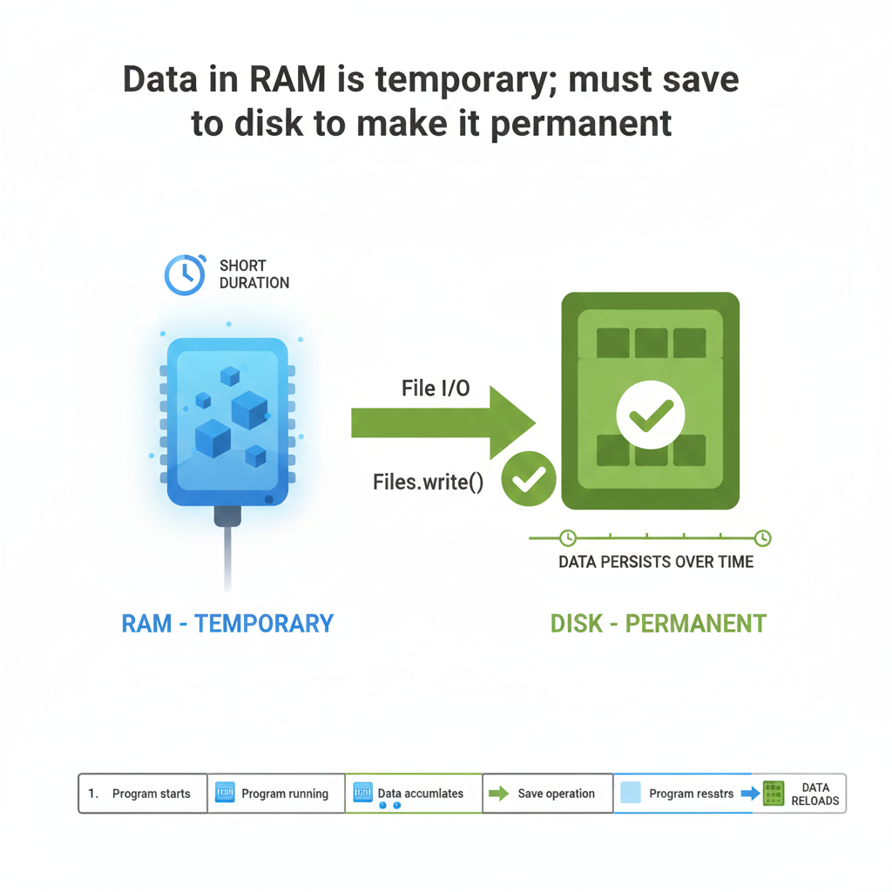
The Persistence Problem
In-memory data vanishes when the application stops running
Variables live in RAM; temporarily cleared when program ends
Real systems must store data permanently to disk or database
File I/O enables programs to read and write persistent storage

Slide 4

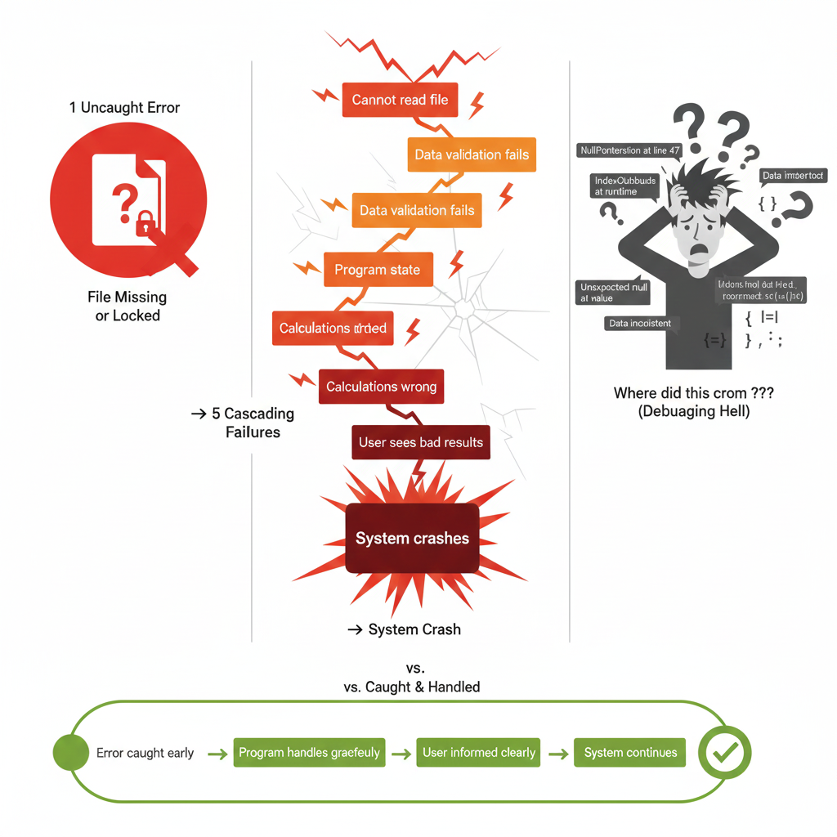
The Error Reality
Code fails for reasons beyond your control
Files might not exist or be locked by other programs
Assumptions about data often prove wrong at runtime
Ignoring errors creates cascading failures hard to debug

Slide 5

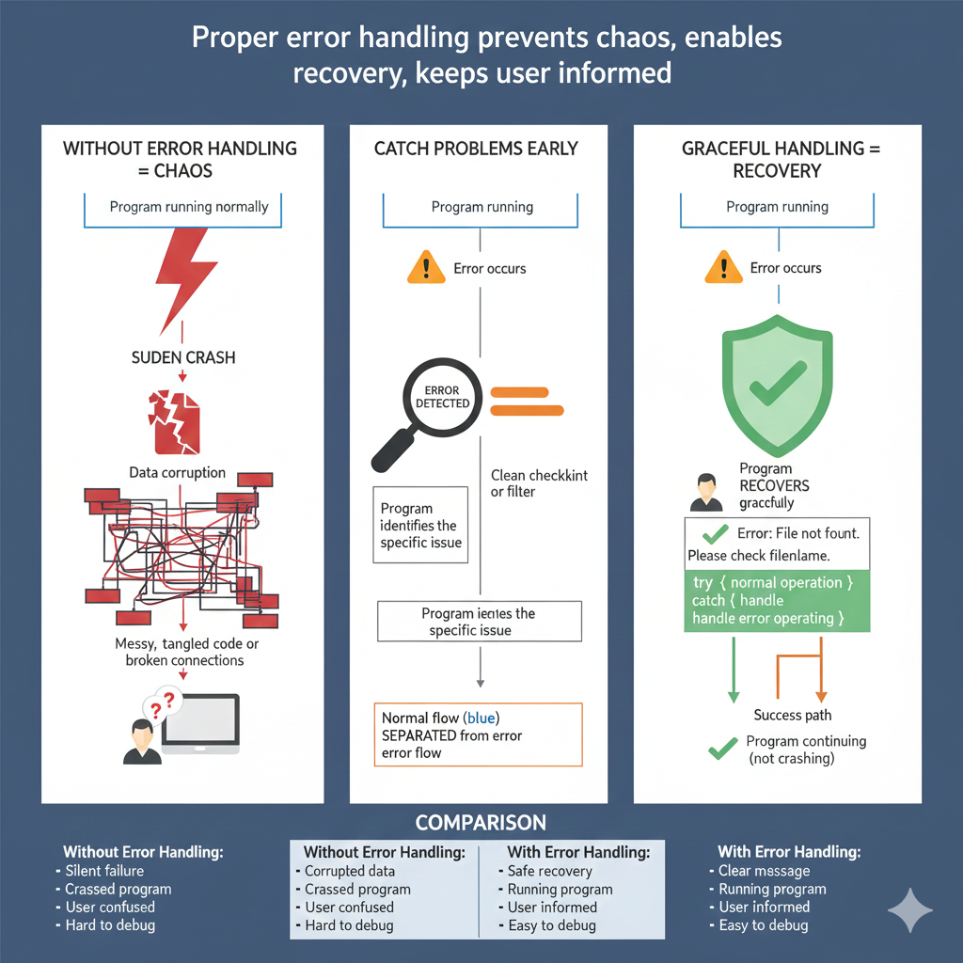
Exception Handling as Defense
Exceptions are controlled interruptions allowing graceful handling of unexpected situations
Program can detect problems before they cause data corruption
Code can attempt recovery or fail cleanly with clear messages
Separates normal flow from error

Slide 6

Core Concepts Exceptions

Slide 7

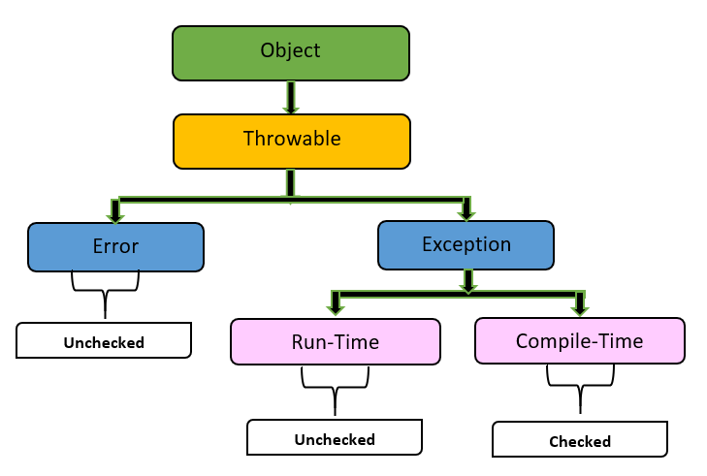
Exception hierarchy
Java exceptions form a hierarchy from general Throwable down to specific error types
Throwable is root of all exceptions errors are most severe system level
Exception is for recoverable errors checked at compile time
Specific exceptions like IOException FileNotFoundException extend Exception

Slide 8

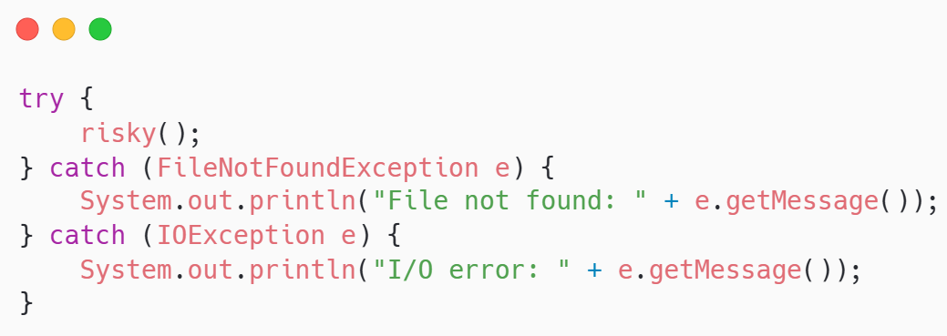
Try – catch blocks
Try-catch wraps code that might fail and provides recovery handlers
Try block contains risky code that might throw an exception
Catch block executes if exception occurs matching the declared type
Multiple catch blocks handle different exception types differently

Slide 9

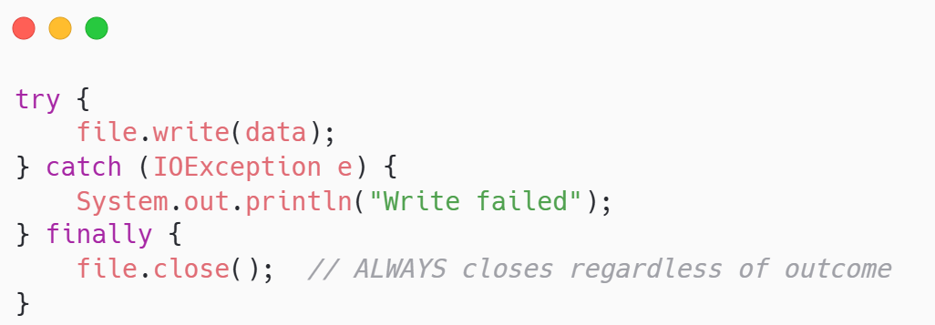
Finally block
“Finally” always executes whether exception occurred or not guaranteeing cleanup
Finally block runs after try completes or catch handles exception
Used for cleanup: closing files streams connections releasing resources
Most reliable place to guarantee resource release

Slide 10

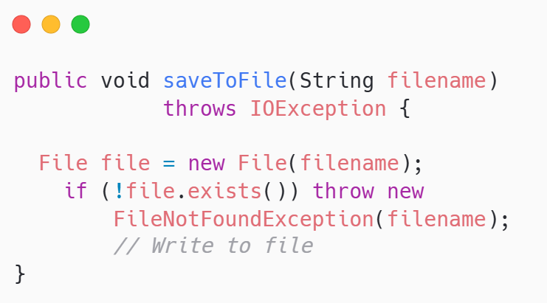
Throws Declaration
Methods can declare exceptions they throw passing responsibility to caller
Throws keyword lists exceptions
Caller must handle those exceptions or declare throws itself
Propagates exception handling responsibility up the call stack

Slide 11
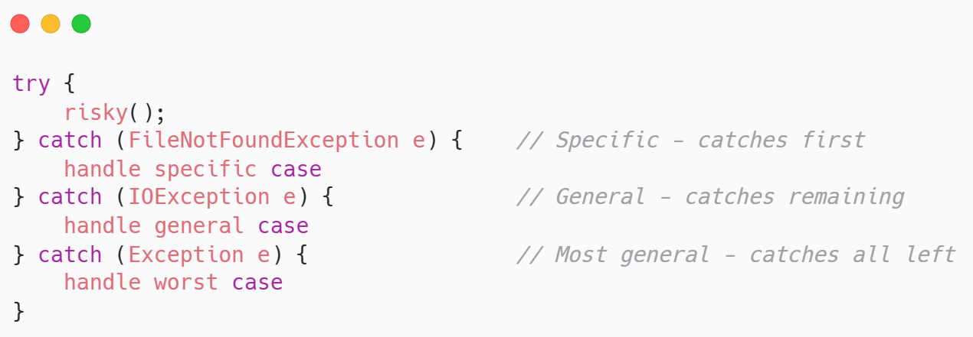
Exception Priority Order
Catch blocks execute from the most specific to the most general catching first match
Specific exceptions must come before general ones
FileNotFoundException is more specific than IOException so must come first
Compiler enforces this

Slide 12
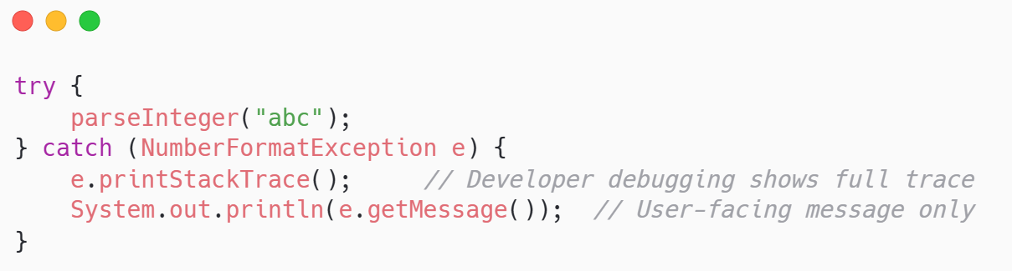
Exception Messages and Stack Traces
Exception objects contain crucial debugging information message and call stack
getMessage() returns human-readable description of what went wrong
printStackTrace() prints full call stack showing where exception originated
Use both for debugging but only show message to end users

Slide 13



Common Exception Types
Understanding common exceptions helps write appropriate handlers for typical problems
IOException: generic I/O problem; file doesn't exist; permission denied
FileNotFoundException: specific file not found extends IOException
NumberFormatException: string cannot convert to number invalid format

Slide 14
Core Concepts Files

Slide 15

Text vs Binary Files
Text files store human-readable characters Binary files store arbitrary byte sequences
Text files contain characters encoded as bytes readable with text editor
CSV JSON XML files are text human-readable structured formats
Binary files contain serialized objects or raw data not human-readable
Files
Text
Binary

Slide 16

Reading Text Files
Java provides several approaches to reading text files from lines to custom parsing
BufferedReader wraps FileReader. It provides efficient line-by-line reading (readLine())
Scanner wraps input stream and provides nextLine() and next() method for parsing tokens
Files.readAllLines() reads entire file into list of strings

Slide 17
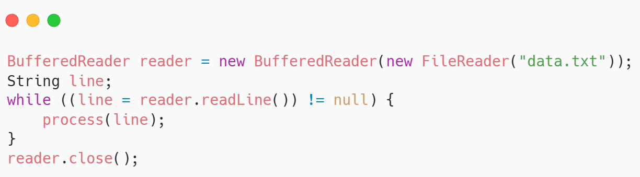
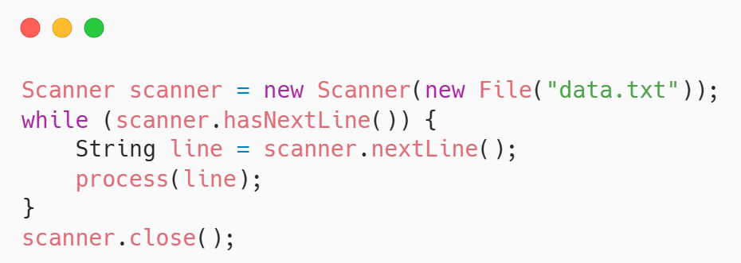
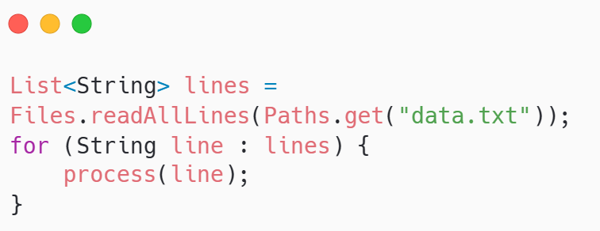
Reading Text Files
Java provides several approaches to reading text files from lines to custom parsing

Slide 18
Writing Text Files
Writing creates new files or overwrites existing ones with character data
FileWriter opens file for writing or creates new file if not exist
BufferedWriter wraps FileWriter for efficient writing adds buffering
write() outputs strings; newLine() adds platform-specific line break

Slide 19
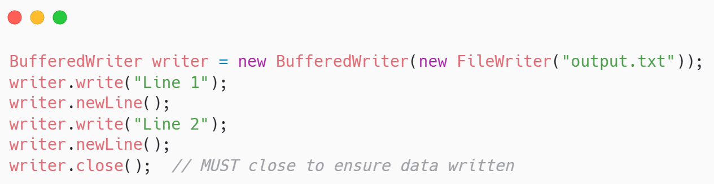
Reading Text Files
Java provides several approaches to reading text files from lines to custom parsing
Must close file to flush buffered data and release system resources

Slide 20

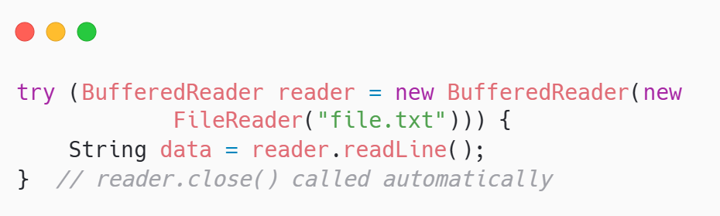
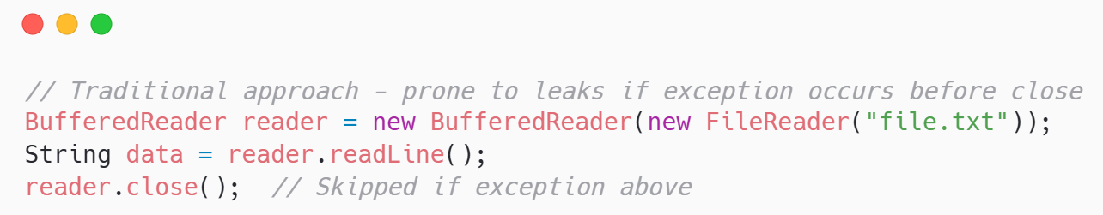
Opening and Closing Resources
Resources must be properly closed
Opening files allocates system resources
Forgetting to close exhausts file descriptors System eventually refuses new files
Finally block or try-with-resources ensures closure even if exceptions occur

Slide 21

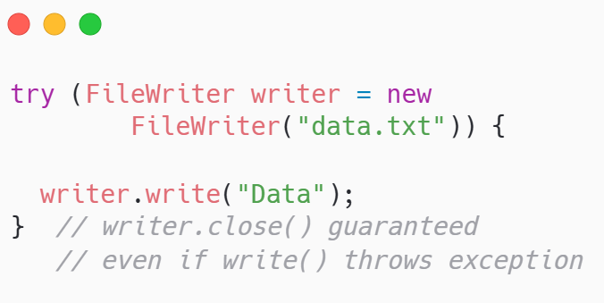
Try-With-Resources Statement
Try-with-resources automatically closes resources
Declares resource in parentheses after try keyword
Resource automatically closed after try block completes successfully or with exception
Cleaner and safer than manual close in finally blocks

Slide 22

File Path Handling
Paths represent file locations relative to working directory or absolute filesystem paths
Relative paths: "data/customers.txt" relative to program working directory
Absolute paths: "/home/user/data/customers.txt" full path from filesystem root
Paths.get() creates Path objects
File.exists() checks if file present
canRead() and canWrite() check permissions

Slide 23

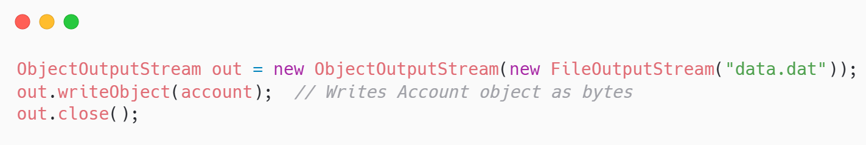
Serialization and Deserialization
Serialization converts objects to byte streams Deserialization reconstructs them
Serialization writes object state to bytes enabling persistence or network transmission
ObjectOutputStream writes serializable objects to files or streams

Slide 24
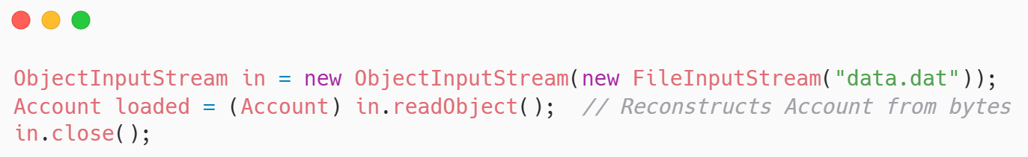
Serialization and Deserialization
Serialization converts objects to byte streams Deserialization reconstructs them
ObjectInputStream reads bytes back reconstructs objects from saved state
Objects must implement Serializable interface

Slide 25

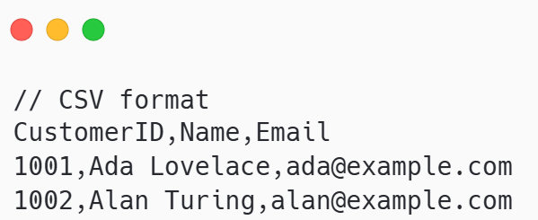
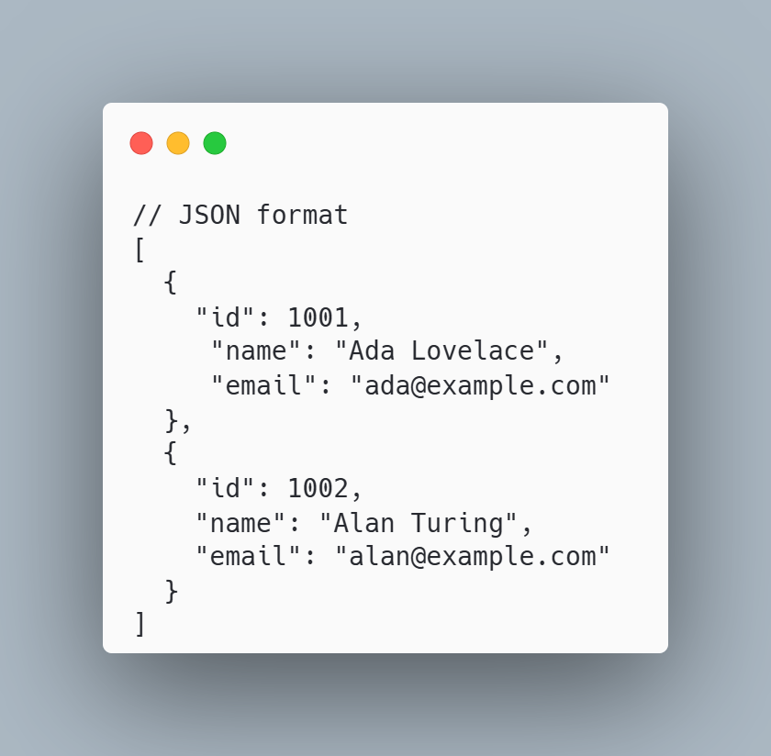
CSV and Structured Text Formats
CSV, JSON, XML formats structure data as text parseable without binary serialization
CSV comma-separated values stores tabular data rows and columns simple portable
JSON JavaScript Object Notation represents hierarchical data human-readable structured
All human-readable languages debuggable flexible platform-independent

Slide 26
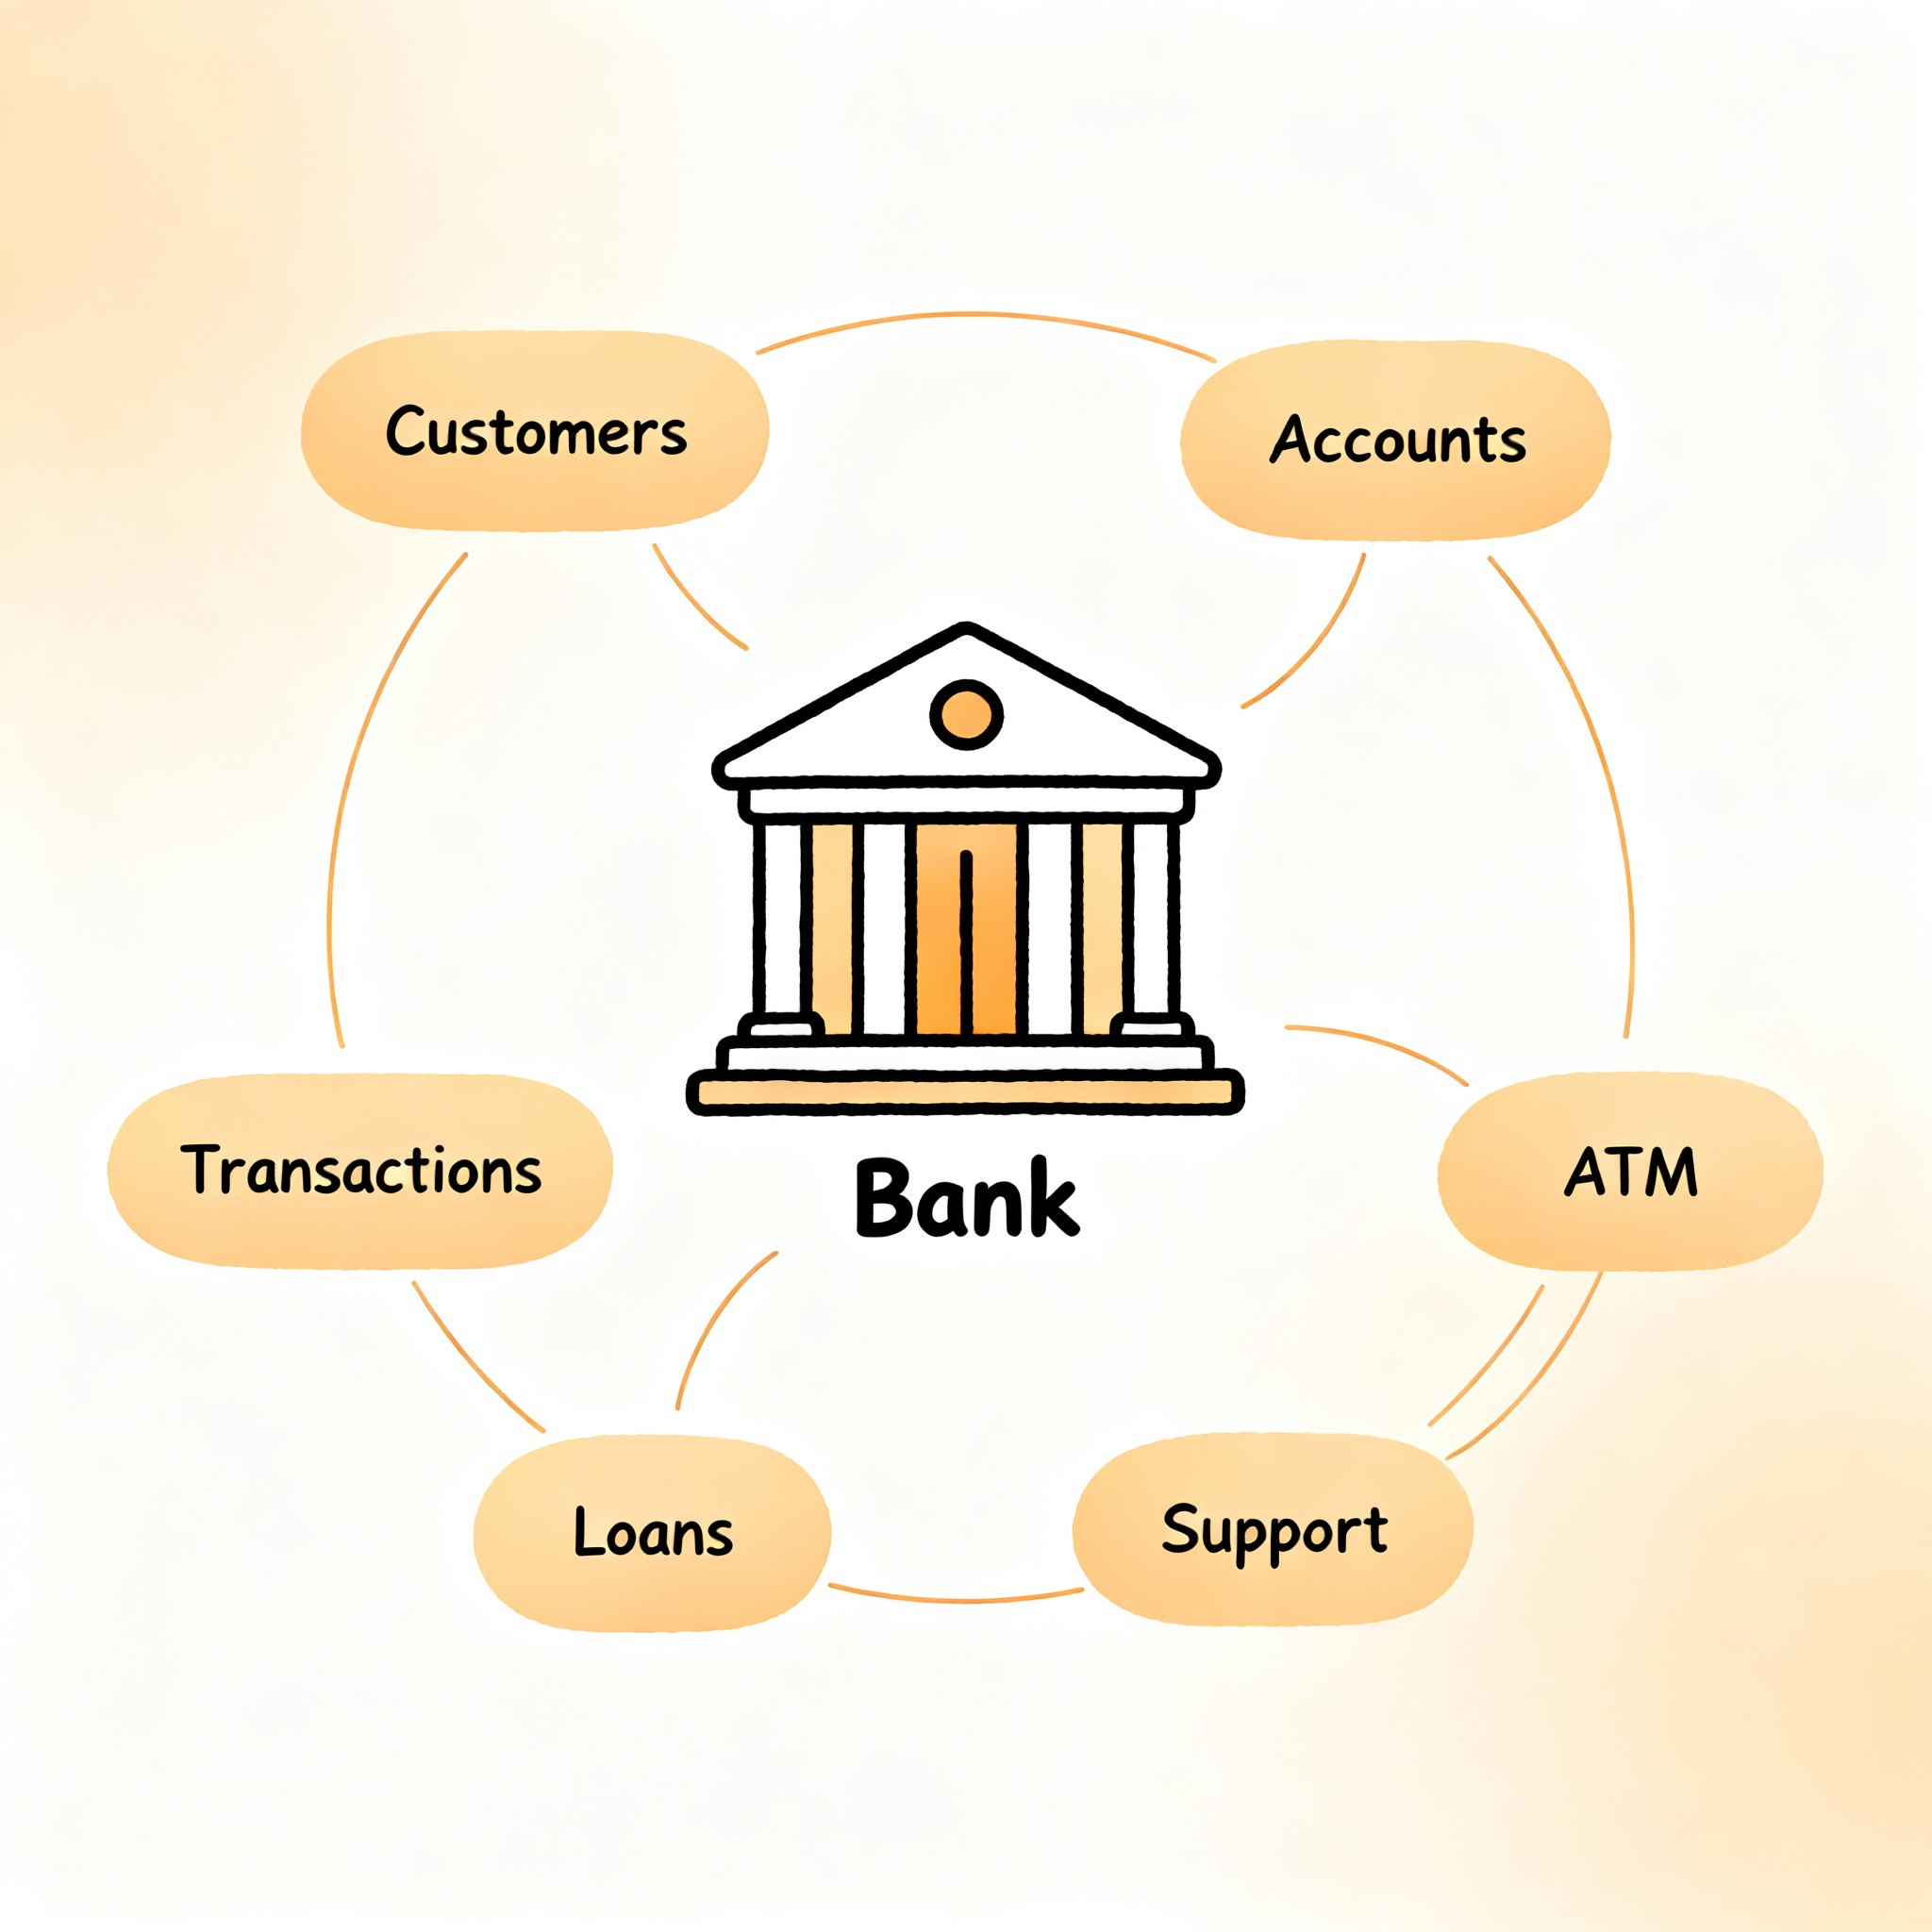
Bank System Example

Slide 27
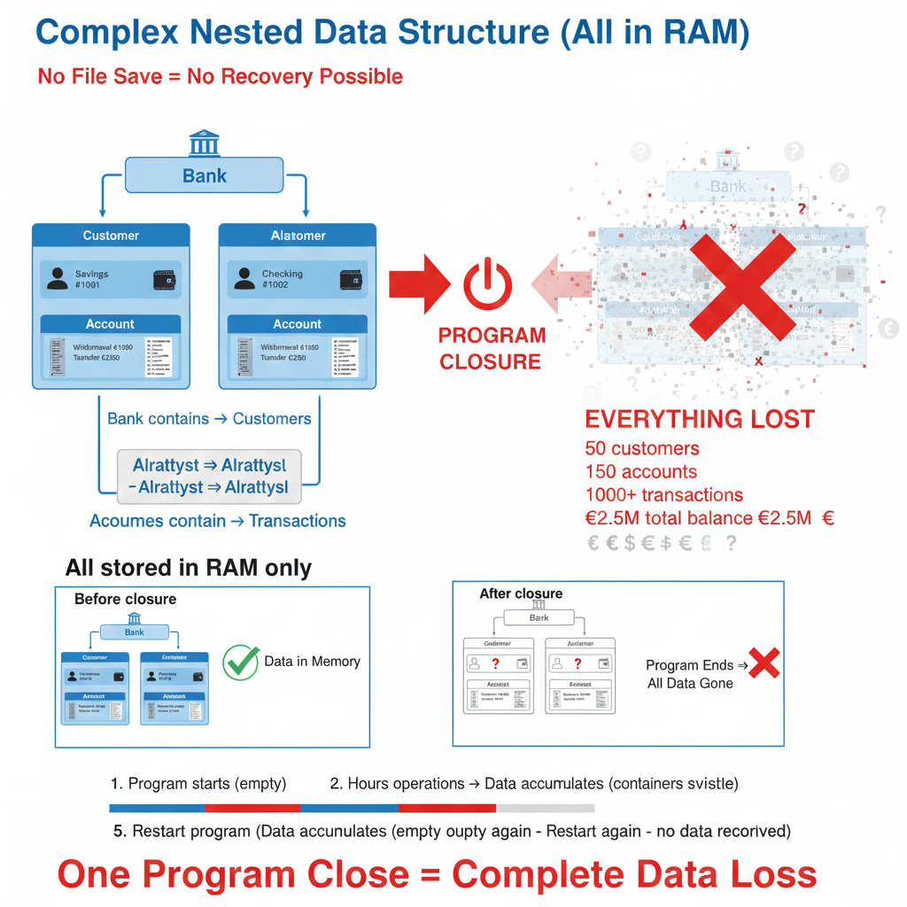
Reviewing Previous Version Architecture
Version 5 had all classes and accounts in memory lost on program termination
Bank stores customers ArrayList Customer stores accounts ArrayList
Account stores transaction history Immutable transactions record all changes
No persistence everything gone when program ends no way to recover data

Slide 28
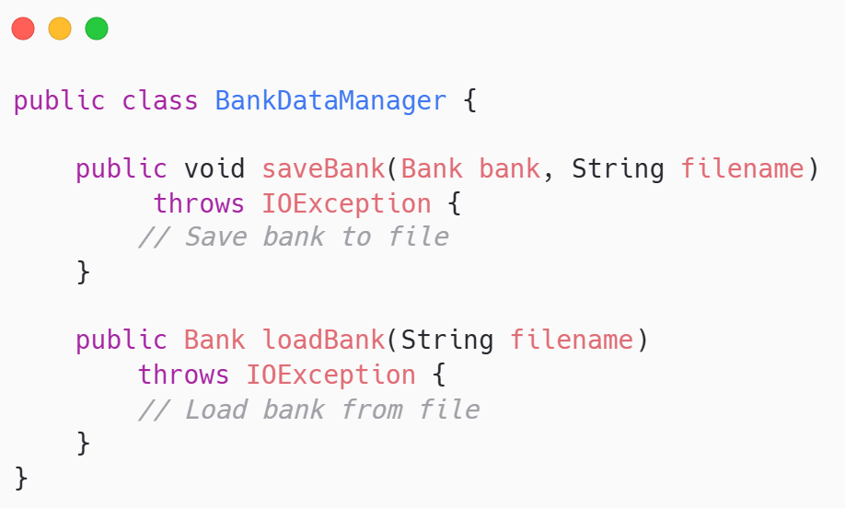
The Bank Data Manager Class
New class centralizes all file I/O for saving and loading complete bank state
Methods: saveBank() saves entire bank to file loadBank() restores from file
Handles all IOException thrown by file operations
Single responsibility: manage persistence all domain classes unchanged

Slide 29

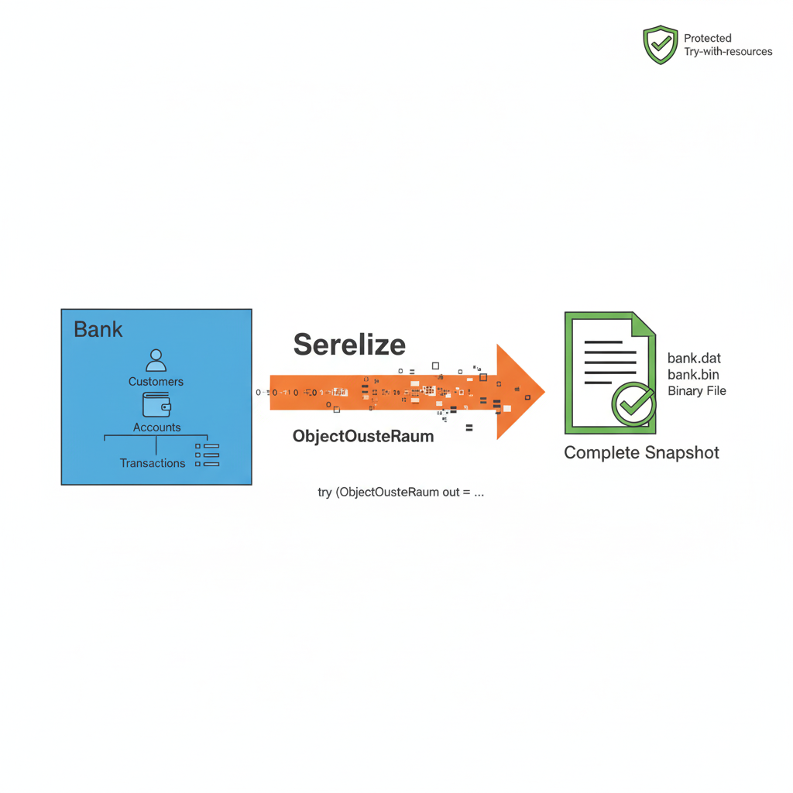
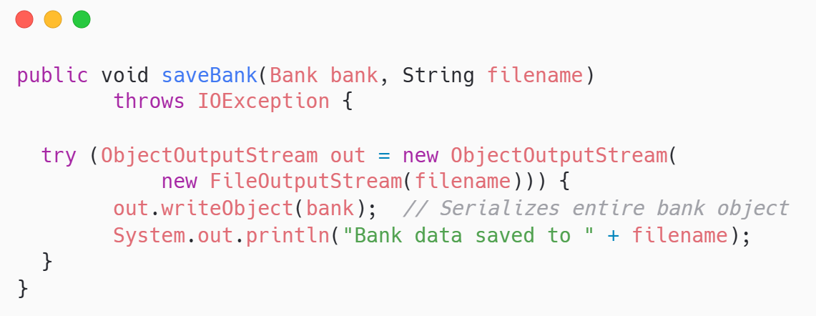
Saving Bank State
saveBank() writes entire Bank object to file using ObjectOutputStream
ObjectOutputStream serializes Bank object, all customers and accounts recursively
Try-with-resources ensures stream properly closed even if exception occurs
Writes binary file containing complete system state snapshot

Slide 30
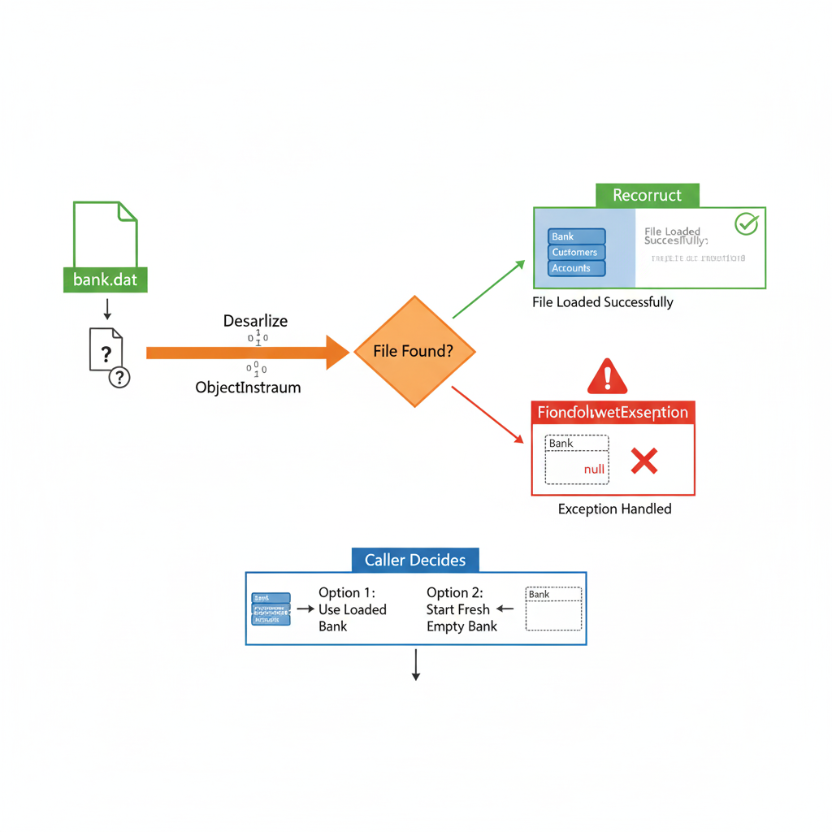
loading Bank State
New class centralizes all file I/O for saving and loading complete bank state
ObjectInputStream reads bytes reconstructs Bank object with all nested data
Catches FileNotFoundException if save file doesn't exist
Caller decides whether to use loaded bank or start fresh empty bank
Reconstruct
Exception
Caller Decides

Slide 31
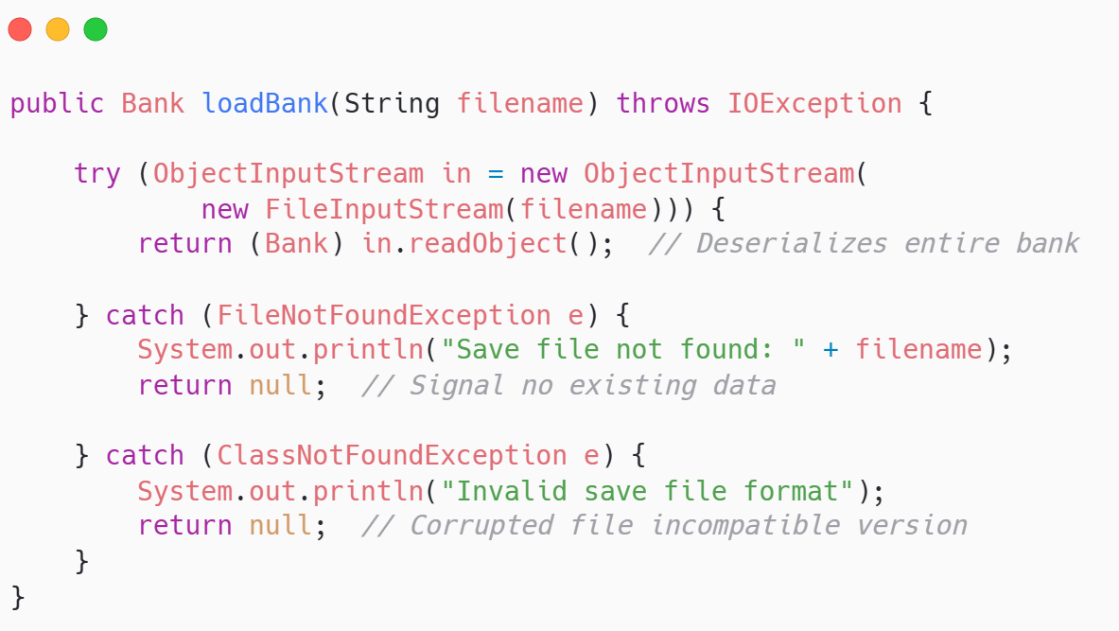
loading Bank State
New class centralizes all file I/O for saving and loading complete bank state

Slide 32

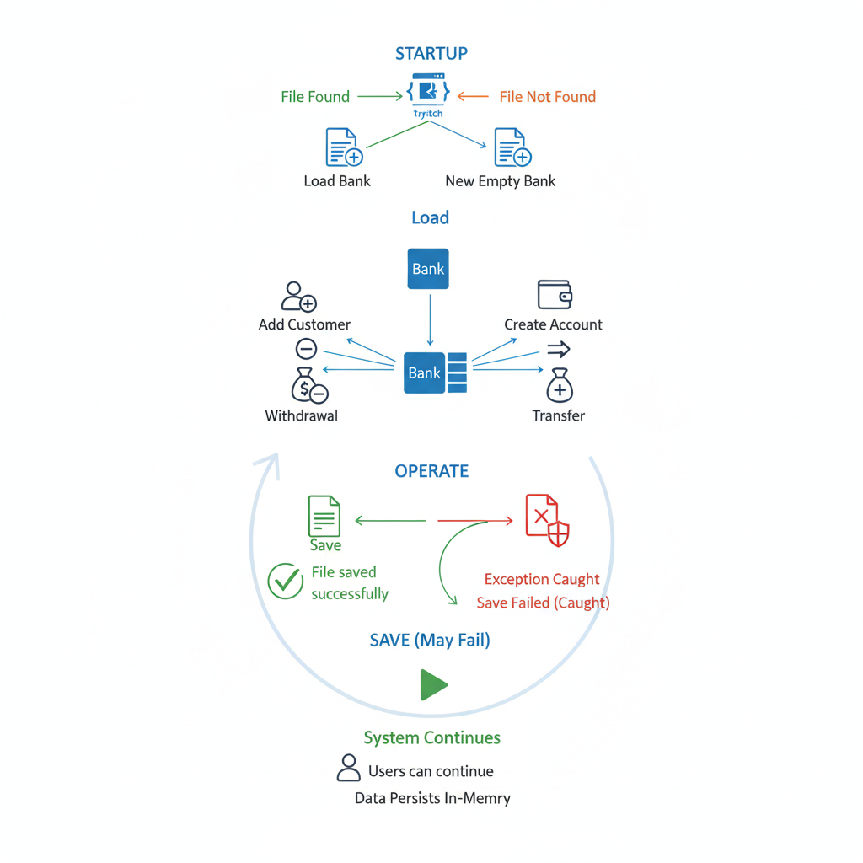
Exception Handling in Main
BankSystemMain wraps save and load operations in try-catch ensuring program survives errors
Loads existing bank data if available Catches FileNotFoundException and uses new bank
Performs operations: add customers, create accounts withdrawals, deposits, transfers
Program continues functioning even if save fails users can continue in-memory

Slide 33
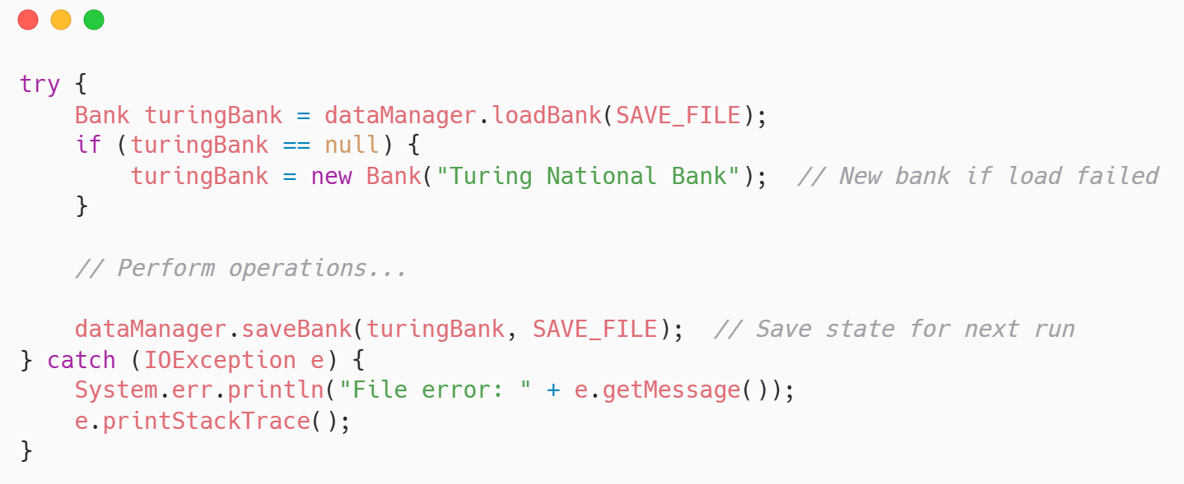
Exception Handling in Main
BankSystemMain wraps save and load operations in try-catch ensuring program survives errors

Slide 34

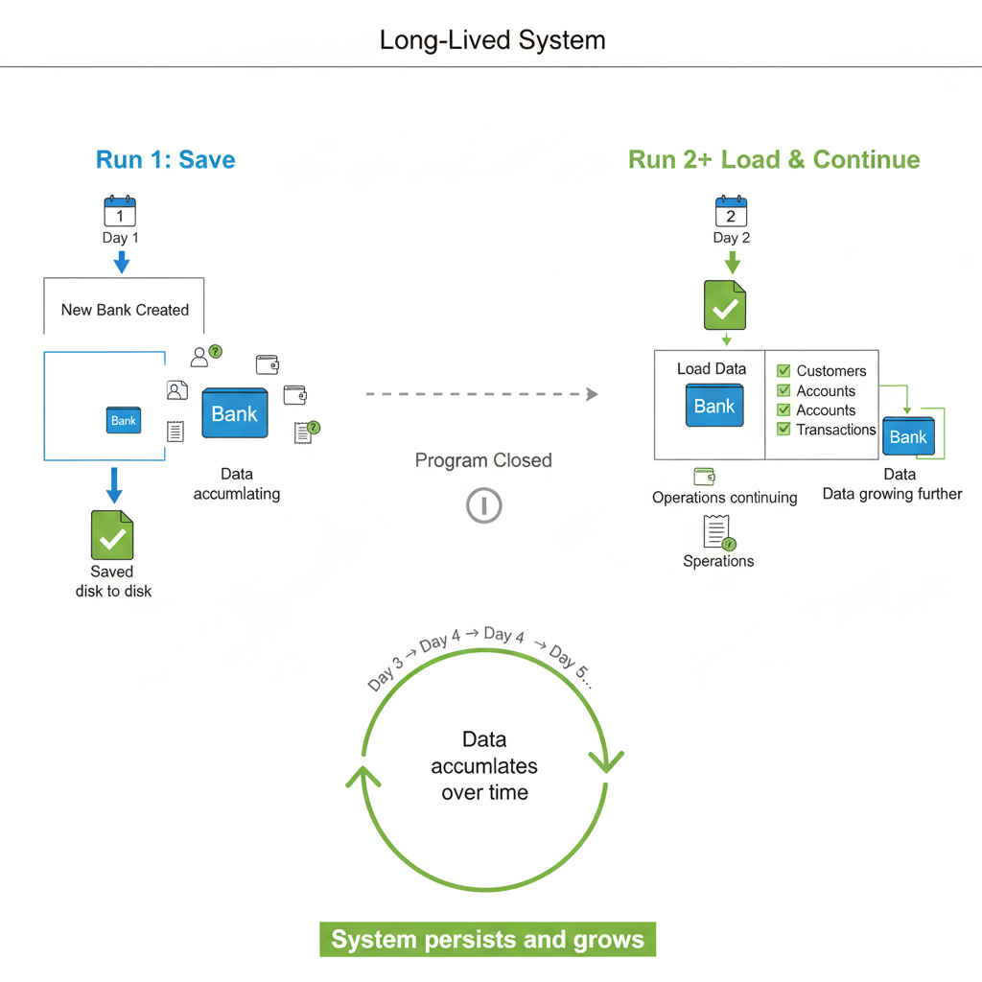
Data persistence across scenarios
Users expect data saved by program to be restored when program runs again
First run: no save file exists → new bank created → fresh transactions performed → saved
Second run: save file found → loaded data restored → customers, accounts, transactions intact

Slide 35

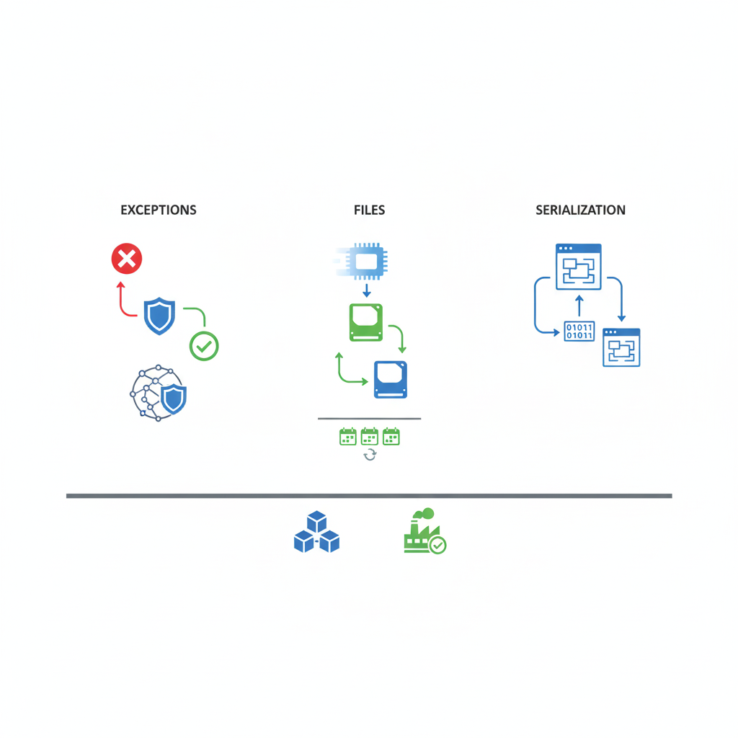
Key takeaways
Exceptions and files transform programs from toys into real systems that persist and survive errors
Exceptions catch errors at source.
Files persist state beyond program runtime and enable sharing data across runs
Serialization enables saving complex objects transparently load them restored

Slide 36


Quote of the week
Errors will find you Be ready when they do

